Slide 1
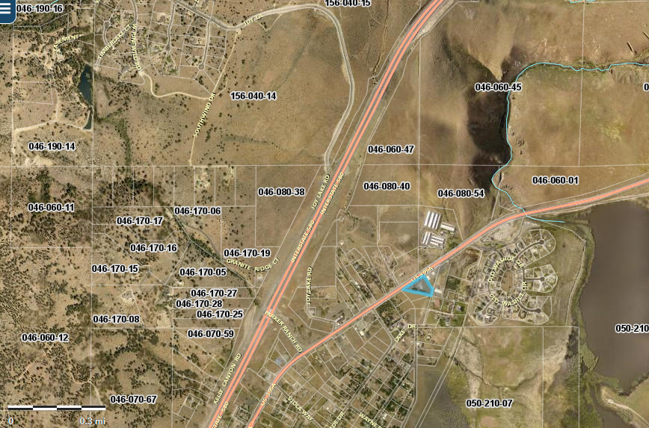
WSUP20-0017
Amundson Roofing
Washoe County Board of Adjustment
Dec 4, 2020

Slide 2
Background/Request
The applicant is requesting to establish a Construction Sales and Services Use type in accordance with the South Valleys Area Plan Old Washoe City Historic Commercial District Character Management Area
The subject parcel is zoned General Commercial

Slide 3
Vicinity Map

Slide 4
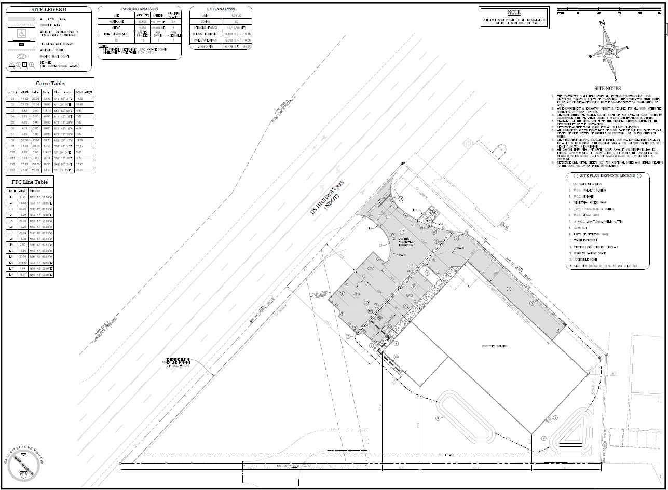
Site Plan

Slide 5
Article 302/304 – Allowed Uses
Construction Sales and Services use type requires approval of a Special Use Permit per 110.302.05.03
  Also required within the Old Washoe City Historic Character Management Area

Slide 6

Article 406 – Building Placement
Application meets the required setback and height requirements

Slide 7
Article 410
Shall meet code requirements for parking standards.
Required to have 17 parking spaces
  4 spaces per office space
  13 space per warehouse area
Required to provide 5 loading spaces

Slide 8
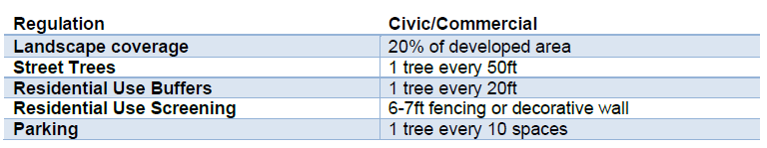
Article 412 - Landscaping
Applicant did not provide a landscaping plan as required
  Required to provide the following per 110.412.45
South Valleys Area Plan
  SV 2.2 – Requirement of a noxious weed plan
  SV 2.8 – Landscaping emphasizing the use of native and low water requirements
Staff has provided conditions of approval requiring a landscaping plan in accordance with Article 412 and in compliance with SV policies 2.2, 2.11

Slide 9
Potential Wetlands
Parcel is impacted by potential wetlands along the eastern property line.
  Per SV policy 27.3 – Development proposals that impact any area designated “potential wetlands” on the Development Suitability map must conduct a wetlands delineation study and obtain Army Corps of Engineers certification of the proposed wetlands.
  Staff has required a wetland delineation study within the conditions of approval.

Slide 10
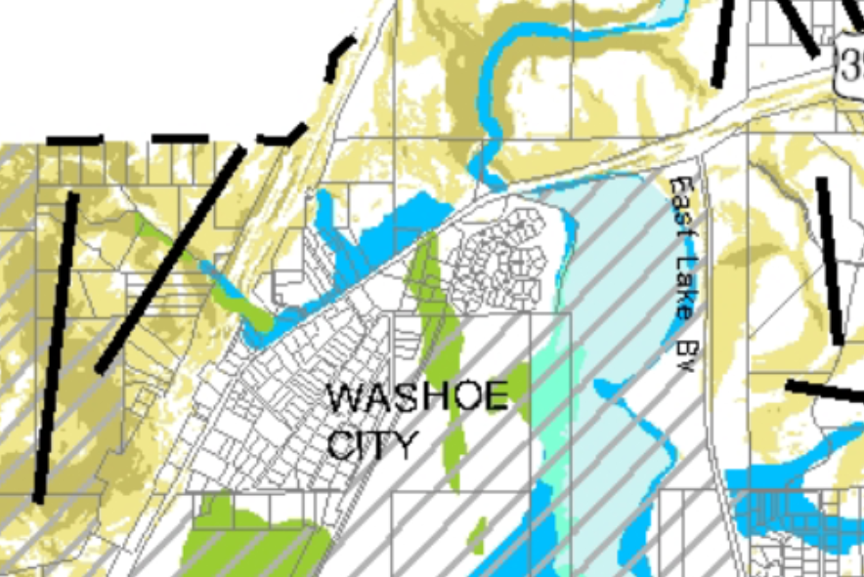
Potential Wetlands
Subject Parcel
Potential Wetlands

Slide 11
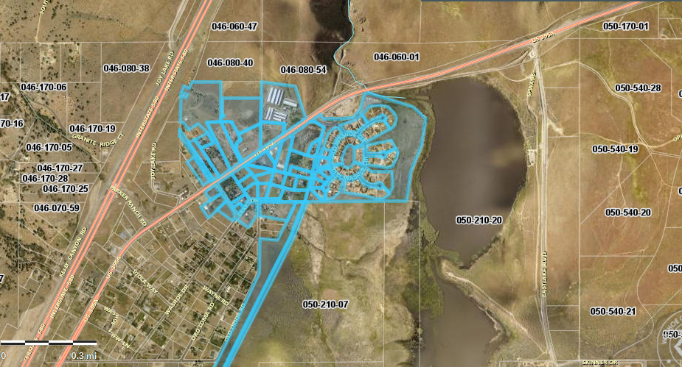
Public Notice & CAB
Notice was sent to 37 affected property owners, 750 feet from the site.

Slide 12
Citizen Advisory Board
Proposed project presented Nov 5, 2020
  CAB had no concerns
  Voted unanimously in favor

Slide 13
Special Use Permit Findings
Consistency. That the proposed use is consistent with the action programs, policies, standards and maps of the Master Plan and the South Valleys Area Plan;
Improvements. That adequate utilities, roadway improvements, sanitation, water supply, drainage, and other necessary facilities have been provided, the proposed improvements are properly related to existing and proposed roadways, and an adequate public facilities determination has been made in accordance with Division Seven;
Site Suitability. That the site is physically suitable for child daycare, and for the intensity of such a development;
Issuance Not Detrimental. That issuance of the permit will not be significantly detrimental to the public health, safety or welfare; injurious to the property or improvements of adjacent properties; or detrimental to the character of the surrounding area;
Effect on a Military Installation. Issuance of the permit will not have a detrimental effect on the location, purpose or mission of the military installation.

Slide 14
Recommendation
Those agencies which reviewed the application recommended conditions to address applicable codes and impacts associated with the project. After a thorough analysis and review, staff recommends that the Board of Adjustment carefully consider all aspects of Special Use Permit Case Number WSUP20-0017 and the nature of the stringent recommended conditions of approval and approve the requested Special Use Permit.

Slide 15
Possible Motion
APPROVAL: I move that, after giving reasoned consideration to the information contained in the staff report and information received during the public hearing, the Washoe County Board of Adjustment approve with conditions Special Use Permit Case Number WSUP20-0017 for Sector 9 LLC, having made all five findings in accordance with Washoe County Code Section 110.810.30

